Slide 1
Store Manager
Валентин Генчев

Slide 2
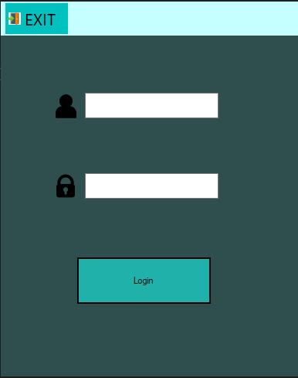
Store Manager
Login
Username
Password

Slide 3

Store Manager
Main menu
Work tabs

Slide 4
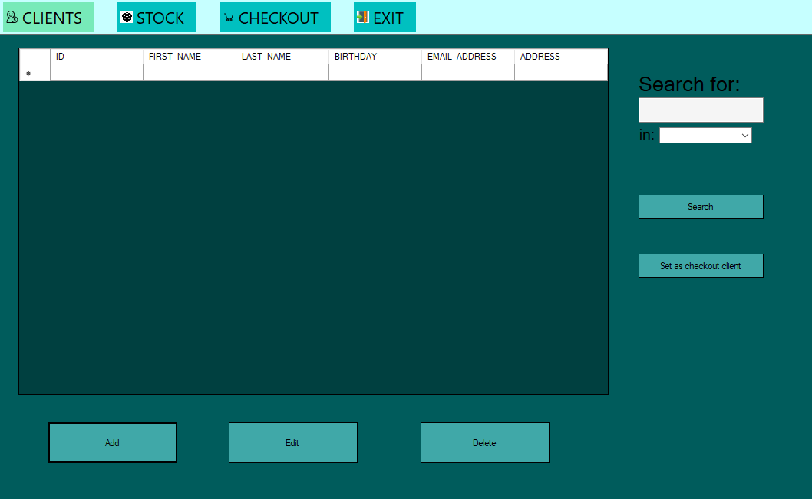
Store Manager - Clients
Clients list
Quick search
Set as checkout client
Edit selected client
Add new client
Delete selected client

Slide 5
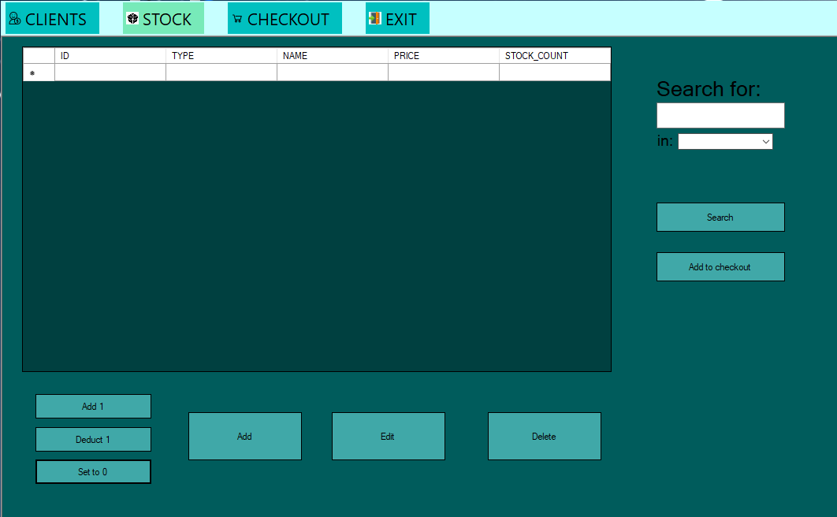
Store Manager - Stock
Stock list
Quick search
Add stock to checkout
Edit selected stock
Add new stock
Delete selected stock
Edit selected stock’s count

Slide 6
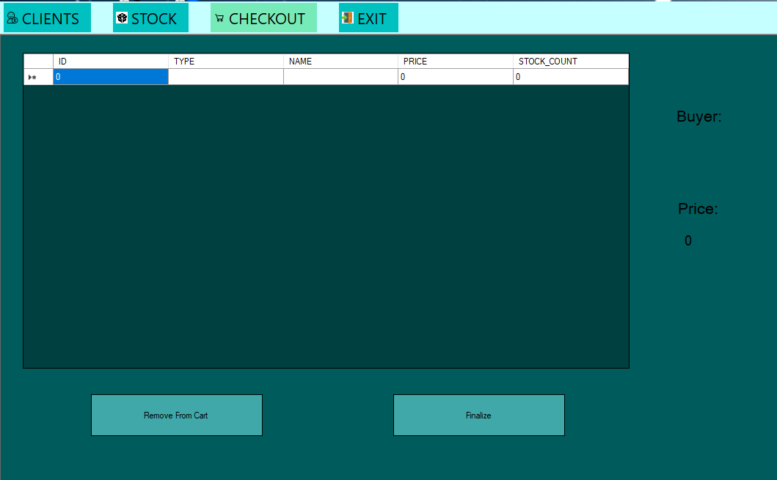
Store Manager - Checkout
Checkout items list
Order buyer
Total order price
Remove item from checkout
Finalize order

Slide 7
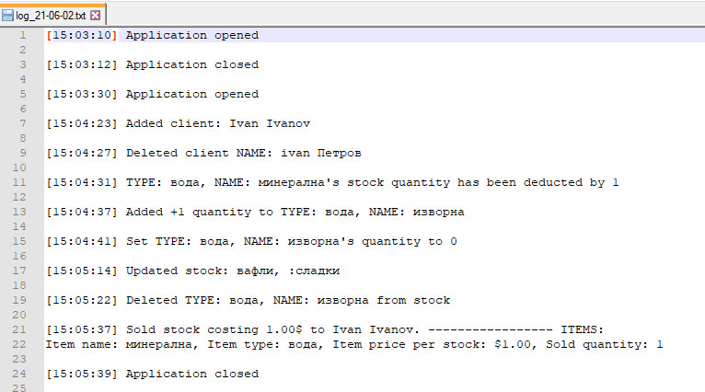
Store Manager - Log

Slide 8
Thank you for your attention!

